Slide 1
A Language Translation LLM Based on the Multi-Agent Debate Method for Educational Assistance

Slide 2
Translate 吃掉敌人一个师 to English
• “吃掉” → “Eat up” • “敌人” → “Enemies” • “一个师” → “A division” (a military unit).
Eat up enemies a division
Eliminate an enemy division.

Slide 3
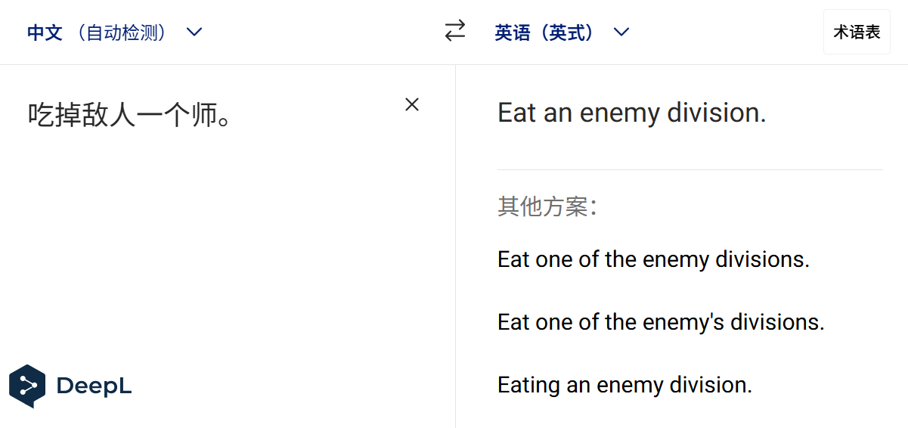
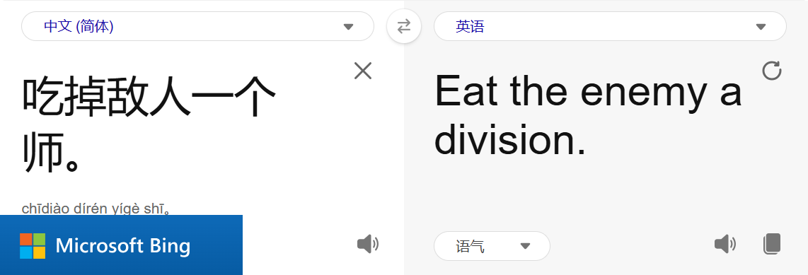
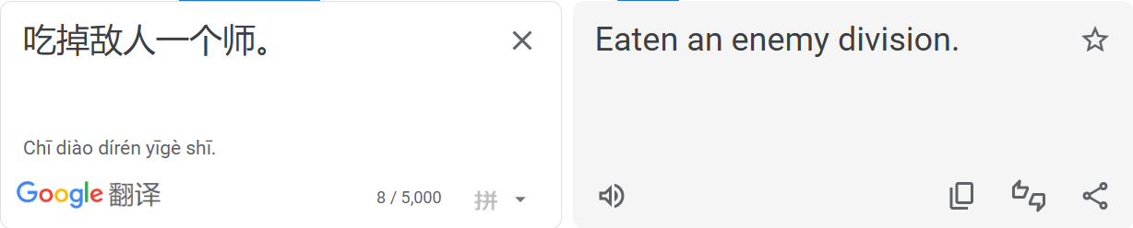

Slide 4
